Slide 1
RUNGTA COLLEGE OF DENTAL SCIENCES & RESEARCH
TITLE OF THE TOPIC- SURGICAL ORTHODONTICS
DEPARTMENT OF ORTHODONTICS AND DENTOFACIAL ORTHOPAEDICS

Slide 2
Specific learning Objectives
CORE AREAS | DOMAIN | CATEGORY
INTRODUCTION | AFFECTIVE | DESIRE TO KNOW
Minor Surgery | AFFECTIVE | DESIRE TO KNOW
Frenectomy | PSYCHOMOTOR | NICE TO KNOW
Removal of supernumerary teeth & odontomes | PSYCHOMOTOR | MUST KNOW
Surgical Exposure of Impacted Teeth | PSYCHOMOTOR | MUST KNOW
Corticotomy | PSYCHOMOTOR | MUST KNOW
Osteotomy for RME | PSYCHOMOTOR | NICE TO KNOW

Slide 3
CONTENTS
PART I
Introduction
Minor Surgical Procedures
1. Frenectomy
2. Pericision
3. Extractions
Removal of supernumerary teeth and odontomes
4. Surgical exposure of impacted tooth
5. Corticotomy
6. Osteotomy for RME
7. Orthodontic implants

Slide 4
CONTENTS
PART II
1. Resections/orthognathic surgeries
2. Cosmetic surgeries
3. Cleft lip and palate surgery
4. Surgically assisted rapid maxillary expansion
5. Distraction osteogenesis

Slide 5
INTRODUCTION
Surgical orthodontics denotes the surgical procedures that are carried out before, during or after active orthodontic treatment
All surgical procedures in conjunction with orthodontics require careful planning.
SURGICAL AIDS TO ORTHODONTICS The role of these surgical interventions is to:
Prevent or correct periodontal problems,
Facilitate and hasten orthodontic treatment,
Reduce relapse & add to postorthodontic stability
Improve esthetics and function for the patients.

Slide 6
Minor Surgical Procedures | Major Surgical Procedures
1. Frenectomy 2. Surgical exposure of impacted tooth 3. Pericision 4. Corticotomy 5. Transpositioning of teeth 6. Removal of soft tissue barrier 7. Extractions a. Therapeutic extractions b. Serial extractions c. Removal of supernumerary tooth d. Removal of fractured roots e. Removal of impacted tooth f. Removal of grossly mutilated tooth 8. Removal of cysts and odontomes 9. Orthodontic implants | 1. Resections/orthognathic surgeries 2. Cosmetic surgeries 3. Cleft lip and palate surgery 4. Surgically assisted rapid maxillary expansion 5. Distraction osteogenesis

Slide 7
SOFT TISSUE PROCEDURES
LABIAL FRENECTOMY Indications When a median diastema is being caused or held open by a thick, short and fibrous labial frenum which is attached to the incisive papilla.
Sometimes, this frenum may insert in the intermaxillary suture area on the palatal aspect.

Slide 8
SOFT TISSUE PROCEDURES
LABIAL FRENECTOMY Diagnosis:
The etiology of diastema could be confirmed with a blanch test.
In this test, when the upper lip is lifted, tension is created on the frenal fibers, and blanching will occur on the palatal side incisive papila.
A V-shaped suture with a notch in the intermaxillary segment, as visualized in the radiograph is a diagnostic sign for potential relapse following orthodontic treatment.
Hence, an indefinite retention plan with bonding of the central incisors lingually is suggested.

Slide 9
SOFT TISSUE PROCEDURES
LABIAL FRENECTOMY Technique:
The frenectomy procedure involves excision of the entire frenum.
The interdental tissue along with its attachment to the bone and the incisal papilla are removed.
The technique suggested by Corn is adopted, which solves the problem of lack of regeneration of the incisive papilla.
Two parallel incisions are made from the tip of the incisive papilla palatally, through the center of the interdental papilla leaving tissue on the mesial aspect of the incisors.
The entire frenum and the incisive papilla are removed; wound is sutured and covered with periodontal dressing for a week.

Slide 10
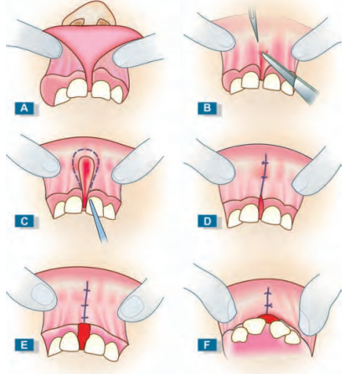

Slide 11
SOFT TISSUE PROCEDURES
LABIAL FRENECTOMY Technique:
It is better to first close the space orthodontically, then carefully resect the fibrous attachment and ligate the teeth together immediately afterward. Scarring then assists closure.
If surgery is done before space closure, scar tissue may form and hinder elimination of the diastema.
There is also a tendency for superior remodeling of the labial frenum, following closure of diastema.
Following space closure, if an irreversible hypoplastic tissue is found, then frenectomy needs to be performed to revert it to normal gingival form and enhance post-treatment stability

Slide 12
SOFT TISSUE PROCEDURES
LINGUAL FRENECTOMY ANKYLOGLOSSIA
The band of tissue connecting the tongue to the floor of the mouth is called the lingual frenum.
Occasionally this frenum might be congenitally short, thick, or tight, or may extend too far down along the tongue or the gum.
An unusually thick, large, or tight lingual frenum can seriously constrict the movement of the tongue and this condition is called “tongue-tie” or ankyloglossia.

Slide 13
SOFT TISSUE PROCEDURES
LINGUAL FRENECTOMY ANKYLOGLOSSIA
Symptoms and clinical features
Children may have difficulty breastfeeding as infants and may later develop lisping.
The patient is unable to clear away food from the roof of the palate and from labiobuccal sulci.
Some patients may develop an open bite because of the pull of the frenum on the jaw and tongue thrusting. Clinical Features
The tongue acquires a heart shape when raised.
The patient cannot extend tongue out to a point and it curves down when extended.

Slide 14
SOFT TISSUE PROCEDURES
LINGUAL FRENECTOMY ANKYLOGLOSSIA
Treatment
A frenectomy is performed using either a scalpel or a CO2 laser.
The surgeon excises the frenum or performs a Z-plasty in order to mobilize the tongue.
When conducted with a laser, the surgery tends to cause very little bleeding, does not require sutures, and often results in very little post-procedure discomfort.

Slide 15
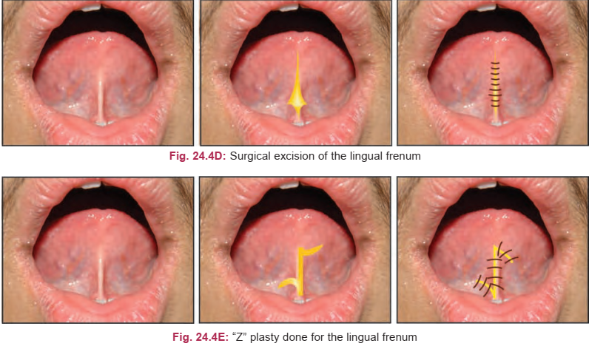

Slide 16
SOFT TISSUE PROCEDURES
CIRCUMFERENTIAL FIBEROTOMY/ PERICISION The supracrestal gingival fibers have high propensity for relapse following rotation correction.
So these fibers are surgically excised, following mild overcorrection of rotated teeth.
The overcorrections are removed 1 week after surgery and before impression for retainers.
Synonyms: Supracrestal fiberotomy, Circumferential supracrestal fiberotomy, Sulcus slice procedure, Edward procedure

Slide 17
SOFT TISSUE PROCEDURES
CIRCUMFERENTIAL FIBEROTOMY/ PERICISION Principle
The main reason for relapse after orthodontic treatment is rebound of the network of elastic supracrestal gingival fibers.
When the teeth move to new position, these fibers are stretched and remodeling of these fibers takes a long time.
Pericision involves elimination of the pull of elastic supracrestal gingival fibers by sectioning these fibers.
Teeth are held in the corrected position when the fibers heal, thereby reducing the relapse caused by elasticity of the gingival fibers

Slide 18
SOFT TISSUE PROCEDURES
CIRCUMFERENTIAL FIBEROTOMY/ PERICISION Treatment
Under local anesthesia, the sharp point of the fine blade (No. 15 BP blade) is inserted into the gingival crevice up to the alveolar crest of the bone.
The blade is kept parallel to the tooth surface. The blade is passed around the circumference of the tooth.
This severs the fibers connecting tooth to the gingival soft tissues.
Cuts are made interproximally on each side of the rotated tooth.
Cuts are made along the labial and lingual gingival margins also. If the labial gingiva is thin, this cut is eliminated.

Slide 19
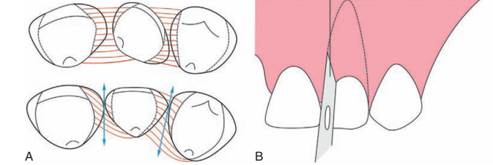

Slide 20
SOFT TISSUE PROCEDURES
EXPOSURE OF IMPACTED TEETH Indications An unerupted canine may be a candidate for surgical exposure if: 1. There is no sign of the tooth even after normal eruption age. 2. Adequate room in the arch is present or can be created orthodontically or by extraction of some other tooth. 3. Potential path of eruption is unobstructed by other teeth. 4. Radiographically the root is not dilacerated.

Slide 21
SOFT TISSUE PROCEDURES
EXPOSURE OF IMPACTED TEETH Technique
Under LA or GA, cruciform incision is made over the estimated position of the crown of the unerupted tooth.
The four triangular flaps are raised and after determining the crown position, the flaps are excised.
A sharp chisel or gouge is used with hand pressure to remove the overlying bone.
The tip of the cusp, the cingulum and the greatest mesial and distal convexities of the crown are exposed.
The surrounding bone is carefully chiselled to create a shallow cavity (saucerization).
The cavity is packed with cotton impregnated with zinc-oxide eugenol paste for 10-14 days.
A bracket may be cemented at the time of exposure or later to aid in eruption

Slide 22
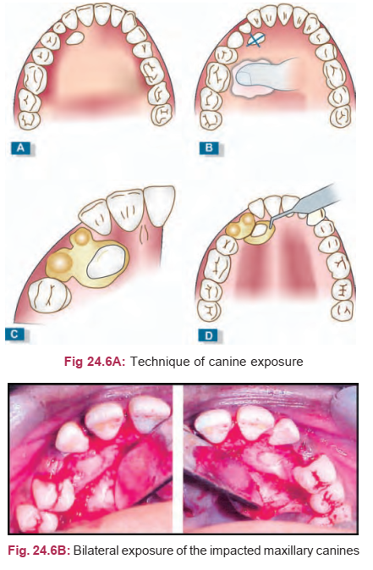

Slide 23
HARD TISSUE PROCEDURES
REMOVAL OF OBSTRUCTION TO ERUPTION (e.g., supernumerary teeth, odontomes)
Indications Supernumeraries should be extracted because: 1. In the anterior maxillary region, they may prevent eruption of permanent incisors. 2. May cause pressure on the root and lead to malpositioning of adjacent teeth. 3. If erupted, can be the cause for crowding in the arch or may cause periodontal complications 4. There may be a cyst associated with them.

Slide 24
HARD TISSUE PROCEDURES
REMOVAL OF OBSTRUCTION TO ERUPTION (e.g., supernumerary teeth, odontomes)
Indications Odontomes may be complex or compound
They are generally diagnosed accidently on an X-ray only when they cause delayed eruption or gross displacement of related permanent teeth.
Swelling may be an associated finding.
Once detected, an odontoma should be removed as soon as possible to without damaging the adjacent teeth or tooth germs.

Slide 25
HARD TISSUE PROCEDURES
SURGICAL UNCOVERING OF IMPACTIONS AND POSITIONING
Causes of canine Impaction
1. Arch length discrepancy 2. Abnormal developmental position of the tooth germ 3. Deﬂection of canine during eruption as canine has got the longest path of eruption 4. A palatally impacted canine could be because of genetic predisposition. It could also be because of missing lateral incisors.
Sequela of Impacted Canine The possible sequel of a palatally impacted canine are root resorption of adjacent teeth and the impacted canine, formation of dentigerous cyst, infection and referred pain.

Slide 26
HARD TISSUE PROCEDURES
SURGICAL UNCOVERING OF IMPACTIONS AND POSITIONING
A tooth that is impacted needs to be radiographically evaluated to determine its position.
CBCT is the most preferred method to diagnose and localize an impacted tooth now.
Object localization is mainly used to determine the location of a foreign object or an impacted tooth with the jaws. The two methods are: 1. Cross-section occlusal radiograph technique 2. Tube shift technique

Slide 27
HARD TISSUE PROCEDURES
SURGICAL UNCOVERING OF IMPACTIONS AND POSITIONING
Methods of Treatment There are four possible methodologies of treatment. 1. Leave alone: If the canine is asymptomatic without evidence of any infection or pathology, the tooth is left as such in a well-aligned arch. 2. Extract: a. Teeth that are unfavorably positioned. b. Teeth showing signs of pathology. c. Tooth that causes resorption and displacement of adjacent tooth should be extracted.

Slide 28
HARD TISSUE PROCEDURES
SURGICAL UNCOVERING OF IMPACTIONS AND POSITIONING
Methods of Treatment
3. Only surgical exposure: Surgical exposure alone is indicated in the following conditions: a. Favorably positioned canine with the apex close to normal position. b. Unobstructed path of eruption. c. Availability of adequate room or space to accommodate the canine. d. Tooth is not deeply placed. e. Tooth is well within the eruptive period.

Slide 29
HARD TISSUE PROCEDURES
SURGICAL UNCOVERING OF IMPACTIONS AND POSITIONING
Methods of Treatment 4. Surgical exposure and orthodontic alignment: • Insufficient space available. • Tooth requires proper positioning. • Associated with other orthodontic problems.
Correction of unerupted tooth into proper position consists of three stages: 1. Presurgical phase 2. Surgical exposure 3. Postsurgical a. Method of attachment b. Mechanical alignment

Slide 30
HARD TISSUE PROCEDURES
SURGICAL UNCOVERING OF IMPACTIONS AND POSITIONING
Surgical Exposure
When planning for guiding the eruption of canine, the most important aspect is that the tooth should be made to erupt through the attached gingiva and not through alveolar mucosa.
Surgical access can be achieved by an apically repositioned ﬂap. Where the crown is left exposed, the eruption of the tooth is speeded up by bonding an attachment and apply light force on the tooth

Slide 31
HARD TISSUE PROCEDURES
SURGICAL UNCOVERING OF IMPACTIONS AND POSITIONING
Methods of Attachment 1. Placement of wire ligature around the neck of the tooth results in loss of periodontal attachment, because the bone destroyed does not regenerate when the wire is removed. This method is not preferable. 2. Sometimes a hole is prepared in the crown of the exposed tooth and a pin or wire inserted into it. This is connected to the main archwire. 3. The best approach is to expose the crown and directly bond an attachment to the exposed surface. Bonded attachments can be hooks, buttons, brackets or chains

Slide 32
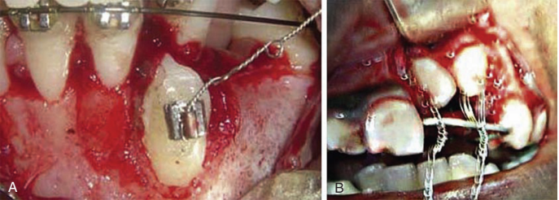

Slide 33
HARD TISSUE PROCEDURES
SURGICAL UNCOVERING OF IMPACTIONS AND POSITIONING
Surgical Removal
The overlying bone is removed with a bur or chisel to expose the entire crown including the tip if it can be done without endangering the standing teeth.
The tooth may now be delivered if the root pattern permits with a Warwick-James elevator applied to its mesial side.
The wound is debrided and closed with interrupted sutures.

Slide 34
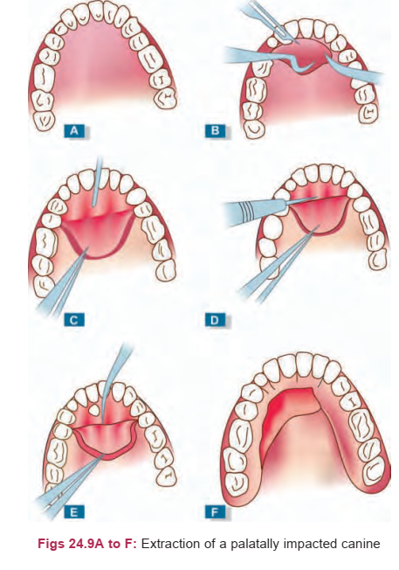

Slide 35
HARD TISSUE PROCEDURES
CORTICOTOMY Indications This procedure is usually carried out on the anterior maxillary teeth in young adults when the duration of appliance therapy needs to be shortened.
One or more teeth can be moved rapidly orthodontically if corticotomy is performed prior to appliance therapy.
There is an increased osteoblastic and osteoclastic activity in the areas around the corticotomy cuts.
This local response is called regional acceleratory phenomenon (RAP) where there is increased bone remodeling in response to local traumatic stimuli.

Slide 36
HARD TISSUE PROCEDURES
CORTICOTOMY Technique
Large labial and palatal mucoperiosteal flaps are raised under LA or GA, to expose both the labial and palatal cortices of the teeth to be moved.
Vertical cuts of predetermined width are made with a bur on either side of each tooth through both the cortices parallel and away from the roots.

Slide 37
HARD TISSUE PROCEDURES
CORTICOTOMY Technique
The apical ends of these cuts are joined by horizontal cuts through the compact bone alone thus leaving the teeth to be aligned supported by cancellous bone.
The flaps are replaced and sutured.
After a delay of 2-3 days, the orthodontic appliance can be fitted and tooth movement rapidly achieved.

Slide 38
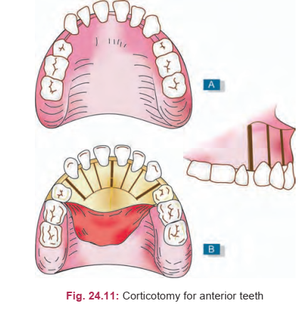

Slide 39
HARD TISSUE PROCEDURES
OSTEOTOMY FOR RAPID PALATAL EXPANSION Indications Adults with skeletal maxillary constriction. Rapid palatal expansion is not possible with orthodontic means alone in these patients because of fusion of midpalatal and lateral maxillary sutures.
Technique A jackscrew expansion device is cemented before surgery and then corticotomies are performed in the lateral antral walls bilaterally.
The midpalatal suture is also osteotomized through a small vertical incision.
The jackscrew is activated and expansion is carried out daily in small increments until complete.
A stabilization period of 6 weeks is required for bony consolidation to occur.

Slide 40
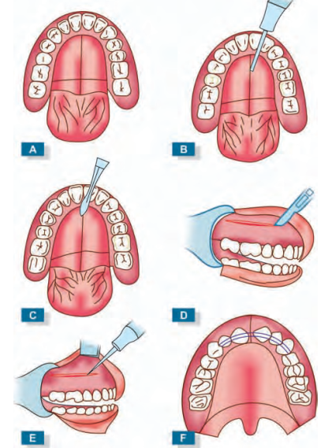
Technique for rapid palatal expansion: (A) Paragingival incision in palate, (B) Midline palatal incision made anteroposteriorly for entire length of exposed bony palate, (C) Midpalatal bony incision continued anteriorly to crest of inter-radicular bone between maxillary central incisor teeth, (D) 4 cm horizontal incision made 1 cm cephalad from junction of free and attached mucosa with root of zygomatic arch as its midpoint, (E) 3 cm bony horizontal incision in exposed lateral antral wall, (F) Rapid palatal expansion device cemented into position

Slide 41
REFERENCES
Textbook of Orthodontics – Gurkeerat Singh, Jaypee Brothers; 2nd Edition
Orthodontics – The Art and Science, S.I Bhalajhi, AryaMedi Publishing; 7th Edition
Textbook of Orthodontics – Sridhar Premkumar, Elsevier; 1st Edition
Orthodontics: Diagnosis and Management of Malocclusion and Dentofacial Deformities – O.P Kharbanda, Elsevier; 1st Edition

Slide 42
Question & Answer Session

